Slide 1
School mapping in ESRI imagery
Andrija Gorup, Dominik Jambrović, Marin Kačan, Siniša Šegvić
November 14th, 2024

Slide 2
Recap from last meeting

Slide 3
Non-school sampling
Previously:
Non-schools sampled throughout Vietnam
Non-schools have no connection to the splits’ schools
Distance-based non-school sampling
Sample non-schools based on distance from schools
Goal: train model only on non-school images geographically close to corresponding school images

Slide 4

Inverse non-school sampling
Schools are split into two clusters
For each cluster, calculate the corresponding centroid
For each non-school (OSM Vietnam data), calculate the Euclidean distance from both centroids

Slide 5
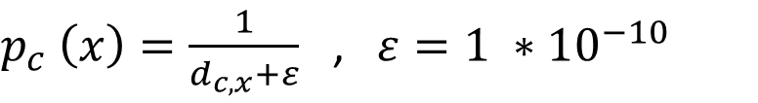
Inverse non-school sampling
Convert distances to probabilities of sampling
Sample non-schools for each cluster individually (no repetition)
$p_{c}$ $\left(x\right)=\frac{1}{d_{c,x}+ε}$ ,$ε=1 ∗{10}^{−10}$

Slide 6
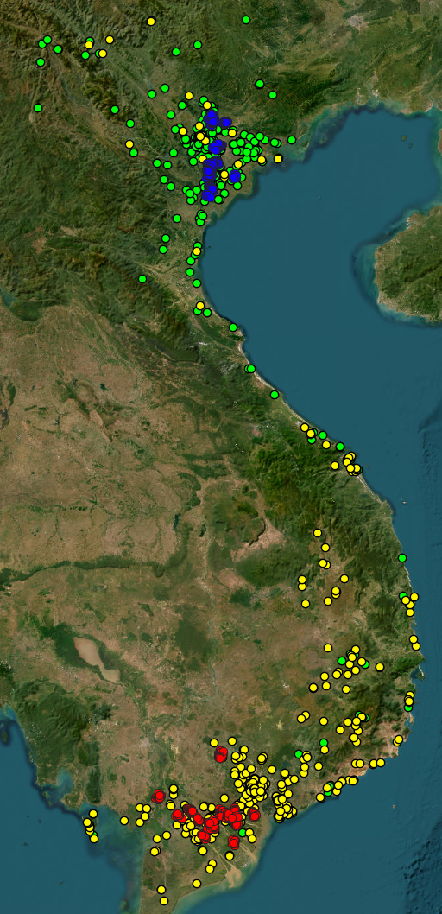
Inverse non-school sampling
- South School Cluster
- South Sampled Non-Schools
- North School Cluster
- North Sampled Non-Schools

Slide 7
Results comparison
Random non-school sampling
F1: 81.55%
P: 95.94%
R: 73.97%
Inverse non-school sampling
F1: 89.03%
P: 97.38%
R: 82.53%

Slide 8
New contributions

Slide 9
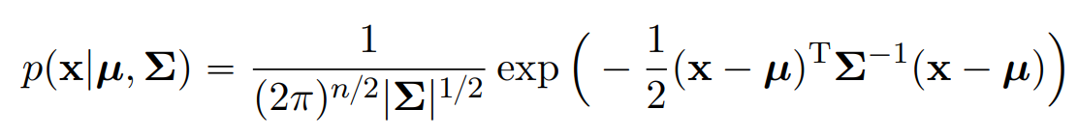
Gaussian non-school sampling
Schools are split into two clusters
For each cluster, calculate the corresponding centroid and variance
For each non-school (OSM Vietnam data), calculate the probability of belonging to a bivariate Gaussian distribution defined by its corresponding centroid and covariance matrix

Slide 10
Gaussian non-school sampling
Use probabilities (normalized bivariate Gaussian PDF) as probabilities of sampling
Sample non-schools for each cluster individually (no repetition)

Slide 11
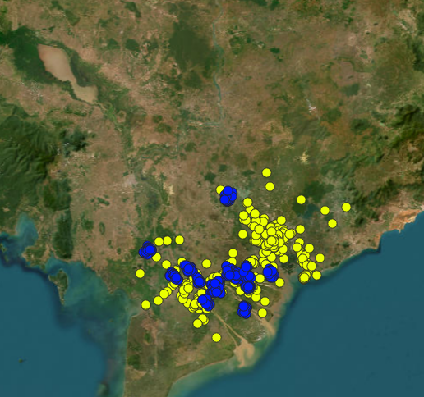
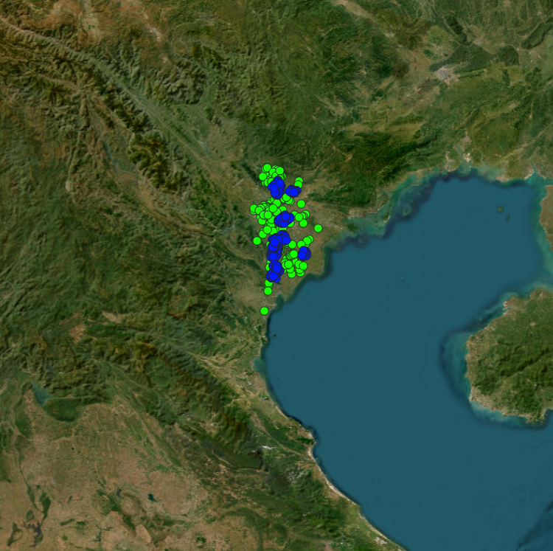
Gaussian non-school sampling
- School Cluster
- South Sampled Non-Schools
- School Cluster
- North Sampled Non-Schools

Slide 12
Sampling comparison
- North School Cluster
- North Inverse Sampled Non-Schools
- North School Cluster
- North Gaussian Sampled Non-Schools

Slide 13
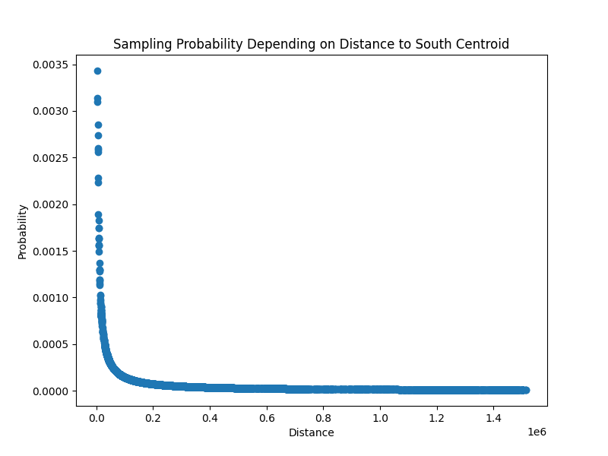
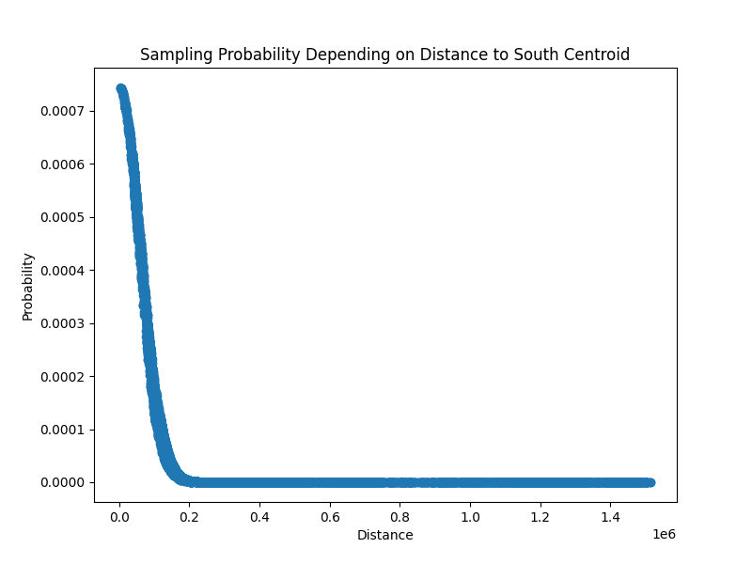
Sampling comparison
Inverse sampling
Gaussian sampling

Slide 14
Results comparison
Inverse non-school sampling
F1: 89.03%
P: 97.38%
R: 82.53%
Gaussian non-school sampling
F1: 89.72%
P: 96.04%
R: 84.98%

Slide 15
Dynamic non-school sampling
Previously:
Non-schools sampled only once (before training model)
Dynamic non-school sampling:
Non-schools sampled independently each epoch
Can be used with both inverse and Gaussian sampling

Slide 16
Results comparison
Static Gaussian non-school sampling
F1: 89.72%
P: 96.04%
R: 84.98%
Dynamic Gaussian non-school sampling
F1: 89.72%
P: 96.32%
R: 84.20%

Slide 17
OHEM non-school sampling
Online Hard Example Mining:
Each epoch, we evaluate the model on all non-schools
For the next epoch, non-schools will be selected:
50% - random examples (inverse or Gaussian)
50% - hard examples
Hard example sampling:
Select false positives (non-schools labeled as schools)
Use model’s confidence score (probability of example being a school) combined with standard (inverse or Gaussian) sampling

Slide 18
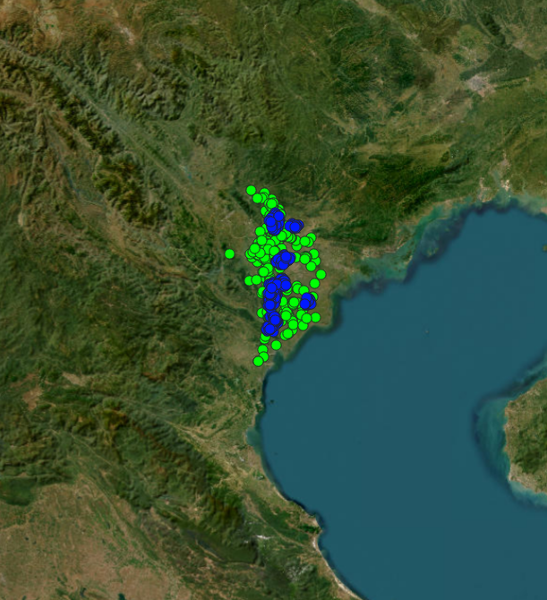
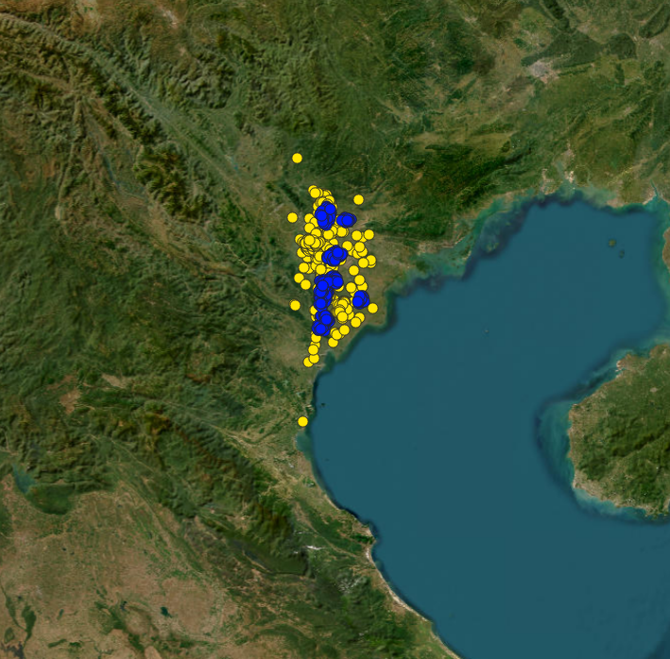
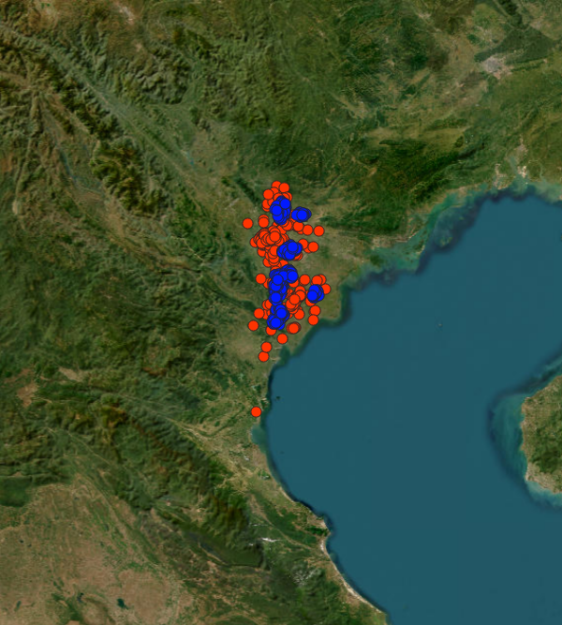
Sampling over epochs comparison
- North School Cluster
- Epoch 1 Non-Schools
- North School Cluster
- Epoch 5 Non-Schools
- North School Cluster
- Epoch 10 Non-Schools

Slide 19
Results comparison
Dynamic Gaussian non-school sampling
F1: 89.72%
P: 96.32%
R: 84.20%
OHEM Gaussian non-school sampling
F1: 88.93%
P: 97.72%
R: 82.15%

Slide 20
Results comparison
OHEM train takes 3x longer
Possible explanation for worse results:
Incorrectly labeled examples
A robust model will classify these examples “incorrectly” with a high confidence score, leading to a high probability of being sampled as a hard example

Slide 21
Sampling method choice
Inverse or Gaussian sampling
Static or dynamic sampling
Dynamic or OHEM sampling
We’ve seen that static Gaussian sampling and dynamic Gaussian sampling yield the best results
Our choice: static Gaussian sampling

Slide 22
Number of epochs validation
Increased number of epochs (20 vs 13)
Measure F1-score over epochs on both train and validation set
Choose an appropriate number of epochs for fine-tuning

Slide 23
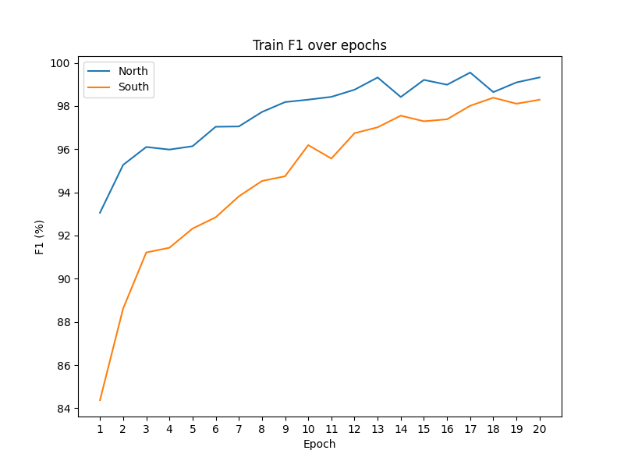
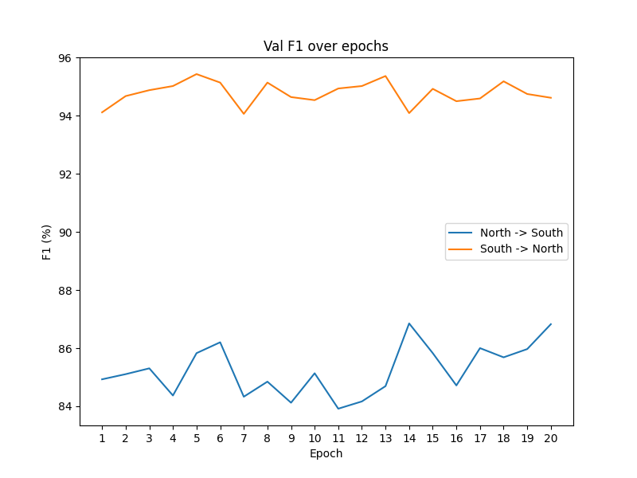
Number of epochs validation

Slide 24
Model fine-tuning
All Anditi schools + equal number of OSM Vietnam non-schools
Static Gaussian non-school sampling
20 epochs
Train results
F1: 99.55%
P: 99.80%
R: 99.30%

Slide 25
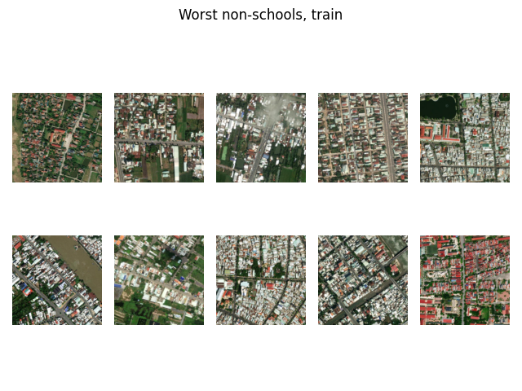

Slide 26
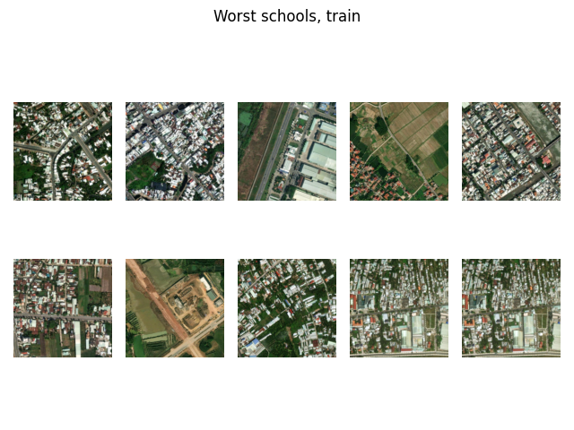

Slide 27
Future work
Dense inference (run newly fine-tuned model on tiles covering the chosen 26 districts)
Suggested deadline: 5.12.2024.

